Slide 1

Wine Quality Prediction Project Synopsis Presentation 20/12/2023
Industrial Training Seminar(IDS553)
B.Tech[Computer Science With Specialization In Data Science (I-Nurture)]
Project Guide:
Shailendra Pal
Manas Chauhan (TCA2166012)
Bhupendra (TCA2166010)
FACULTY OF ENGINEERING & COMPUTING SCIENCES
TEERTHANKER MAHAVEER UNIVERSITY, MORADABAD

Slide 2

Team Details
Student Name | Role
Manas Chauhan | Developer, Testing etc.
Bhupendra | Developer, Testing etc.
2
T011A/ Template Version 1.0

Slide 3
Project Brief
Welcome to the captivating world of "Wine Quality Prediction," where data and vines intertwine to reveal the secrets behind the allure of fine wines.
In this project, we delve into the complexities of acidity, sweetness, and alcohol content like variables , utilizing the Kaggle Wine Quality dataset as our compass. Our goal is clear , to employ machine learning process to forecast and unveil the potential quality of wines based on these inherent characteristics.
Guidelines: Mention brief about the project and it’s functions/ modules
3
T011A/ Template Version 5.0

Slide 4
Methodologies/ Technologies/ Tools to be used
Methodologies:
1) Data Exploration and Preprocessing:
Explore and understand the Kaggle Wine Quality dataset.
Handle missing values, outliers, and ensure data cleanliness.
Visualize data distribution and correlations.
2) Feature Engineering:
Identify and create relevant features that can enhance model performance.
Scale and transform features if needed.
3) Model Selection:
Choose appropriate machine learning models for regression (since wine quality is a continuous variable).
Experiment with algorithms such as Linear Regression, Decision Trees, Random Forest, and KNN.
4) Model Training and Evaluation:
Split the dataset into training and testing sets.
Train the chosen models on the training set.
4
T011A/ Template Version 5.0

Slide 5
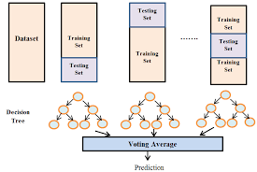
Context Diagram (Overall Project)
5
T011A/ Template Version 5.0

Slide 6
Entity Relationship Diagram (ERD)
+---------------------+ +----------------------+ +-----------------------+
| Raw Data | | Data Preprocessing| | Machine Learning|
| (Wine Quality Dataset)| ---> |(Cleaning, Scaling , | ---> | (Training, Testing, |
+---------------------+ |Feature Engineering)| | Model Evaluation)|
+----------------------+ +-----------------------+
|
|
v
+----------------------+
| Features |
|(Acidity, Alcohol, etc.)|
+----------------------+
|
|
v
+----------------------+
| Wine Quality |
| Prediction |
+----------------------+
6
T011A/ Template Version 5.0

Slide 7
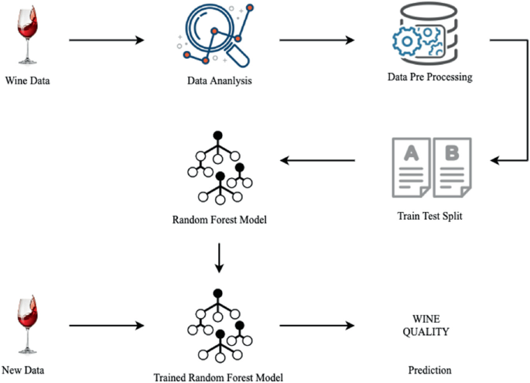
Data Flow Diagram (DFD)
Guidelines: Add more slides, if required to show all DFDs
7
T011A/ Template Version 5.0

Slide 8
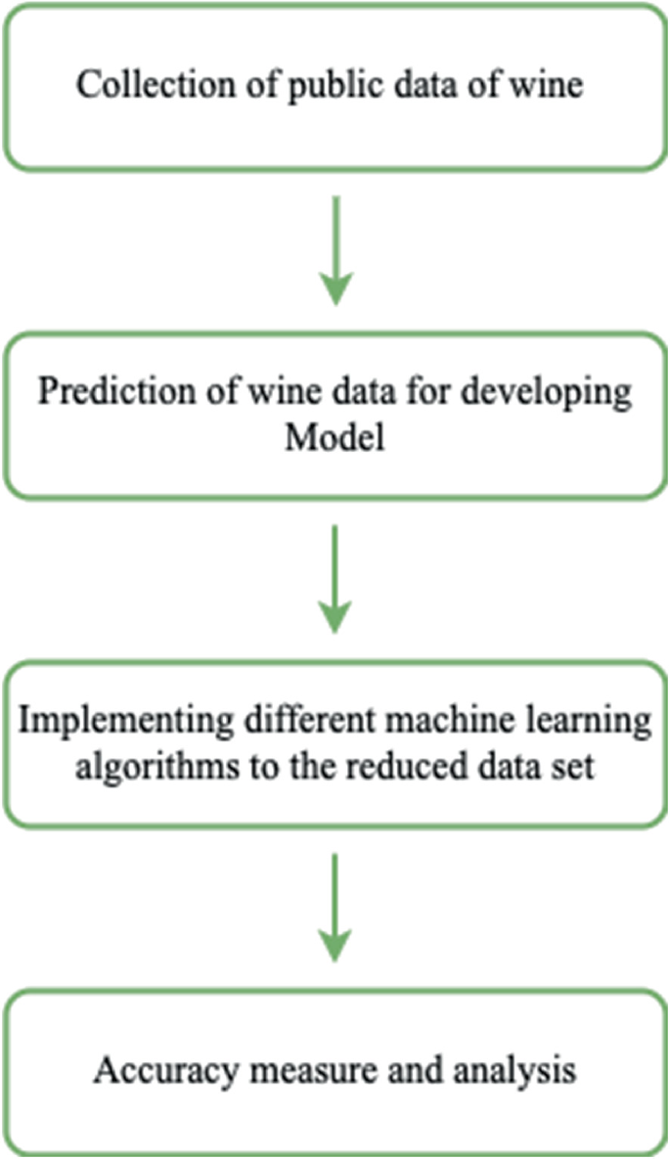
Flow Chart
Guidelines: This slide is optional
8
T011A/ Template Version 5.0

Slide 9
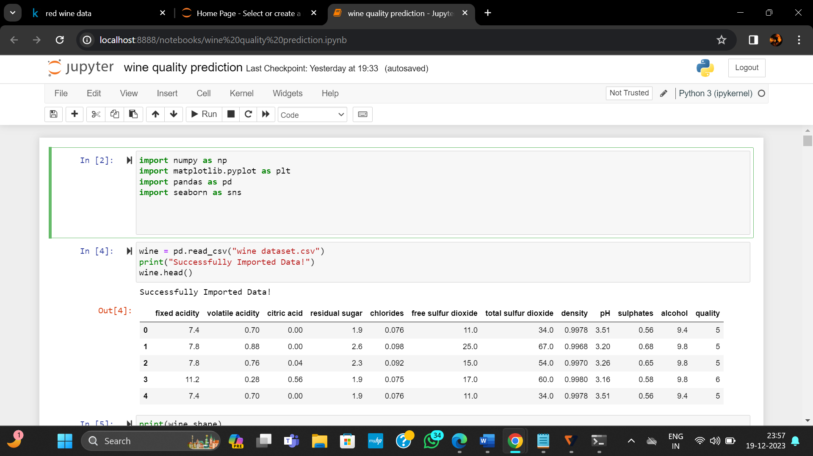
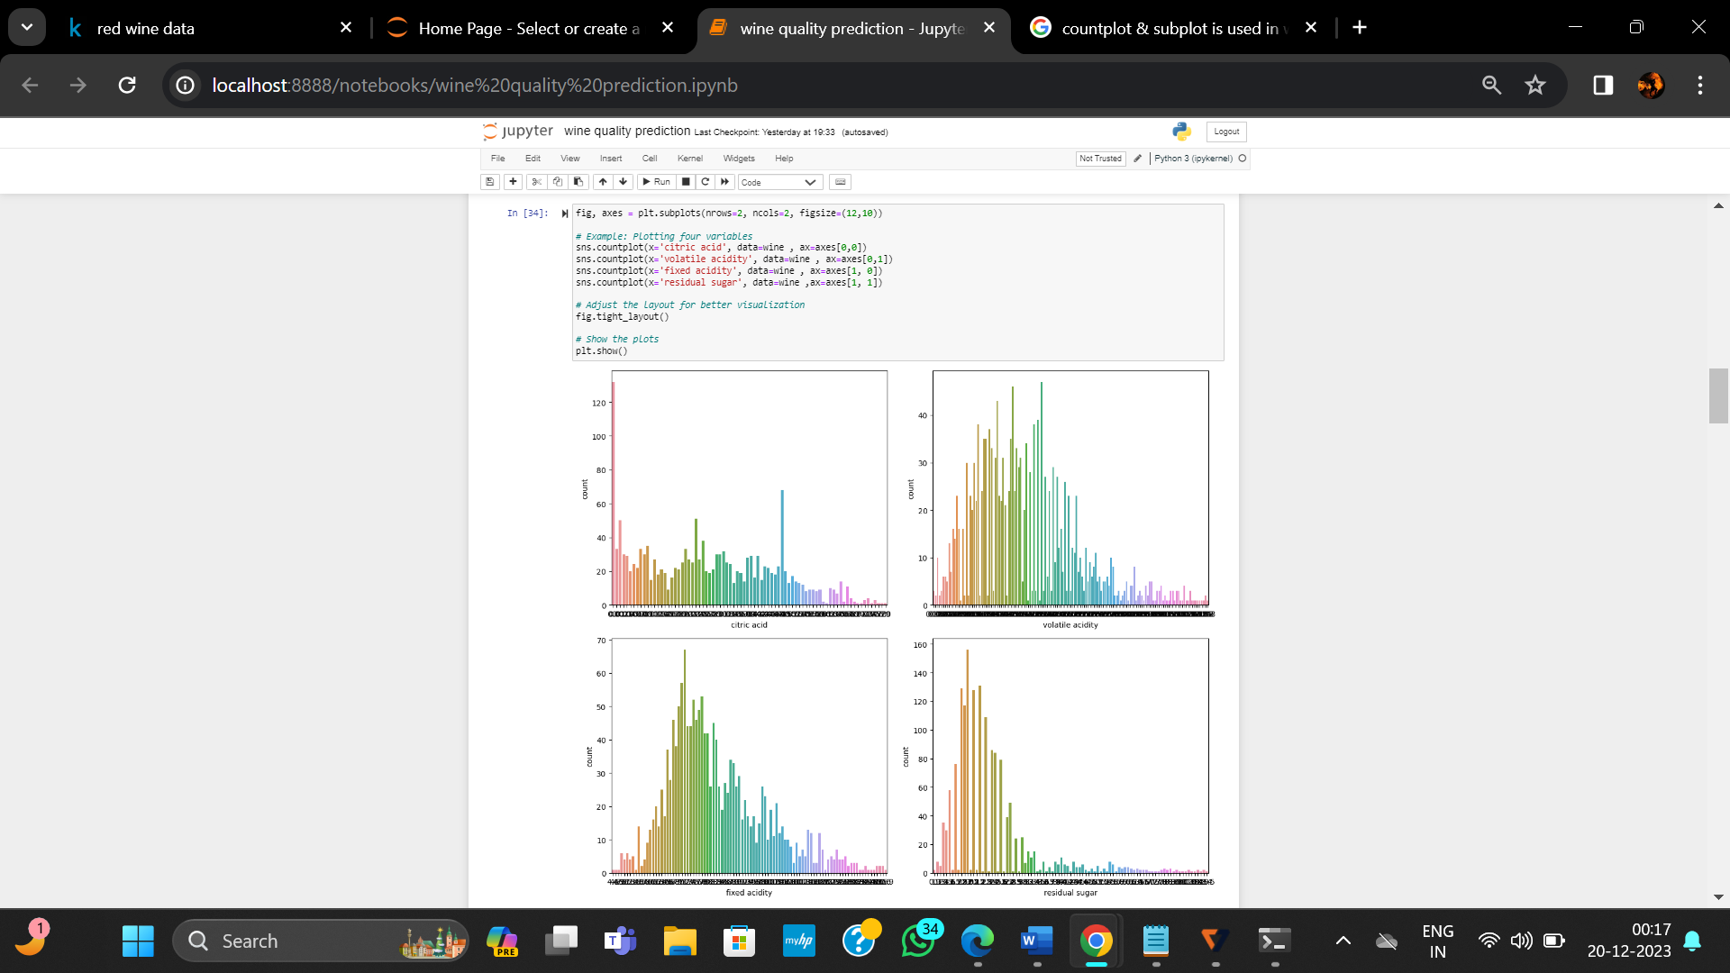
Use Case Diagram
Guidelines: This slide is optional. May add more slide, if the details are available
9
T011A/ Template Version 5.0

Slide 10
\
Advantage of The Project
Improved Quality Control: Machine learning models can analyze a wide range of wine attributes, including chemical composition and sensory characteristics. This enables better quality control during the production process, ensuring that wines meet or exceed desired quality standards.
Data-Driven Decision-Making: Machine learning allows winemakers to make informed decisions based on data analysis. By leveraging predictive models, winemakers can identify key factors influencing wine quality, leading to more precise adjustments in production processes.
Consistency in Production: Predictive models can contribute to the consistency of wine production. By identifying optimal conditions and characteristics associated with high-quality wines, winemakers can strive for consistency in flavor profiles and overall quality across different batches.
Time and Cost Efficiency: Machine learning models can automate and streamline various aspects of quality assessment. This leads to time and cost savings compared to traditional manual methods, where extensive sensory evaluations or lab tests might be required. Early
Detection of Issues: Predictive models can detect potential issues or deviations in the production process early on. By analyzing historical data and real-time inputs, the system can provide warnings or alerts, allowing winemakers to address problems before they impact the final product.
Optimized Production Processes: Machine learning models can reveal complex relationships between different variables affecting wine quality. This insight can be used to optimize production processes, from grape cultivation and harvesting to fermentation and aging, leading to improved overall efficiency.
. Waste Reduction: Optimizing production processes through machine learning can lead to reduced waste. By preventing quality issues or deviations early in the process, winemakers can avoid discarding batches that do not meet quality standards
Guidelines: Mention advantage from this project, the audience/ users who will get benefitted
10
T011A/ Template Version 5.0

Slide 11
References, if any
www.Kaggle.com
www.google.com
11
T011A/ Template Version 5.0

Slide 12
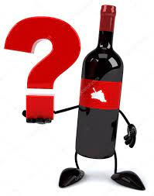

Slide 13
